Slide 1


Minor Project Synopsis Presentation
Team Name – Error_Runtime
MindSpace
Project Category: University Based Problem Statement
Submitted in partial fulfilment of the requirement of the degree of Bachelor of Technology
in
Computer Science And Engineering
Submitted by Projexa Team - 26E1055

Slide 2
Introduction
Project Title
MindSpace: Student Sentiment and Risk Analysis
Sem-II Minor Project Synopsis Submitted By
Student Name | Roll number
Harsh Dev Jha | 2501010168
Manas Bhasker | 2501010226
Trijal Garg | 2501010072
Rishita | 2501010228
Krishyangi Dixit | 2501010156
Kumari Pratibha | 2501010123
Faculty Mentor:
Dr. Shahid Ahmad Wani
1

Slide 3
Role Division
Student Name | Role
Harsh Dev Jha | • Setting up the Flask environment and directory structure. • Designing RESTful Routes (e.g., /upload, /edit). • Managing the database connection for session storage.
Manas Bhasker | • Implementing the Burnout Algorithm logic ((Study/Sleep)*Stress). • Handling Data Cleaning (removing outliers/nulls).
Trijal Garg | • Integrating NLTK/VADER to score text feedback. • creating logic to compare "Mood Scores" vs. "Burnout Scores".
Rishita | • Designing HTML5/CSS3 templates. • Creating the Upload Portal and Editing Table interface.
Krishyangi Dixit | • Debugging •System Testing: Validating CRUD operations and error handling. • Documentation: Writing the Synopsis, Final Report, and ReadMe.
Kumari Pratibha | • Designing the Analytical Dashboard. • Integrating Matplotlib/Chart.js to generate Heatmaps & Pie Charts. • Ensuring charts update dynamically when data is edited.
Faculty Mentor:
Dr. Shahid Ahmad Wani
1

Slide 4
Project Overview
What is Mind Space? A full-stack web application designed to analyze student burnout using a multidimensional approach.
The Core Problem:
Traditional monitoring is episodic (once a semester) and reactive.
Existing data is often "noisy" and lacks emotional context.
The Solution:
Combines Quantitative Metrics (Sleep, Study, Stress) with Qualitative Analysis (Sentiment in feedback).
Features a dynamic "Editing Section" to clean data in real-time.
2

Slide 5
Specific Objectives
Data Management: Develop a Flask portal for ingesting CSV datasets and performing CRUD operations (Create, Read, Update, Delete).
Burnout Quantification: Compute a "Burnout Index" using a weighted algorithm based on lifestyle factors.
Sentiment Analysis: Utilize NLTK (VADER) to detect latent distress in textual student feedback.
Risk Visualization: Generate real-time heatmaps and trend lines to classify students into Low, Medium, and High risk categories.
3

Slide 6
Key Features
Secure Data Portal: Easy ingestion of large-scale academic datasets (CSV/Excel).
Interactive Editing Suite: Allows researchers to fix outliers (e.g., invalid sleep hours) instantly within the browser.
Automated Scoring Engine: Automatically calculates risk scores as soon as data is uploaded or modified.
Sentiment Intelligence: Flags students who report "okay" grades but use distress-signal words in feedback.
Dynamic Dashboard: Visualizations update in real-time as the underlying data changes.
4

Slide 7
Project Summary
MindSpace is a full-stack web application developed by Projexa Team (26E1055) at K.R. Mangalam University to address the critical issue of student burnout. Unlike traditional reactive monitoring systems, MindSpace employs a multidimensional approach by merging quantitative lifestyle metrics with qualitative sentiment analysis.
The platform allows for the ingestion of academic datasets (CSV/Excel) and features a specialized "Editing Suite" to handle data cleaning and outlier removal in real-time. By utilizing a custom Burnout Algorithm and the NLTK (VADER) engine, the system classifies students into Low, Medium, or High-risk categories, providing university counselors and administrators with a real-time, holistic view of student well-being.
8

Slide 8
Detailes Progress: Development Phase
Domain | Component | Progress Summary
Backend & Infrastructure | Environment Setup | Flask environment configured with structured directories for efficient routing
 | Routing & APIs | RESTful APIs implemented (/upload, /edit) for data handling
 | Session Management | SQLite integrated for persistent storage & student record handling
Core Analytics Engine | Burnout Quantification | Burnout Score formula implemented for risk evaluation
 | Data Pre-processing | Pandas/NumPy pipeline: missing values handled, stress levels normalized (1–10)
NLP Module | Sentiment Analysis | Integrated NLTK VADER for processing student feedback
 | Risk Correlation | Linked Mood Scores (-1 to +1) with Burnout Scores to detect hidden risk cases
Frontend & Visualization | UI Design | Responsive HTML/CSS interface with upload & live editing features
 | Dashboard | Real-time charts (heatmaps, histograms, pie charts) using Matplotlib/Chart.js
QA & Documentation | Testing | Debugged CRUD operations ensuring data integrity
 | Documentation | Completed synopsis & initial README with architecture details
8

Slide 9

Methodology
Tech Stack:
Backend: Flask (Python) - Chosen for lightweight routing.
Analytics: Pandas & NumPy - Chosen for vectorized data cleaning.
NLP: NLTK - Natural Language Tool Kit (VADER – Valence Aware Dictionary and sEntiment Reasoner) - Chosen for efficient, rule-based sentiment scoring.
Frontend: HTML5, CSS3.
The Algorithm:
Formula:
Burnout Score = ((Study / Sleep) * Stress) * 10$
Sentiment: Compound Polarity Score (-1 to +1).
8

Slide 10
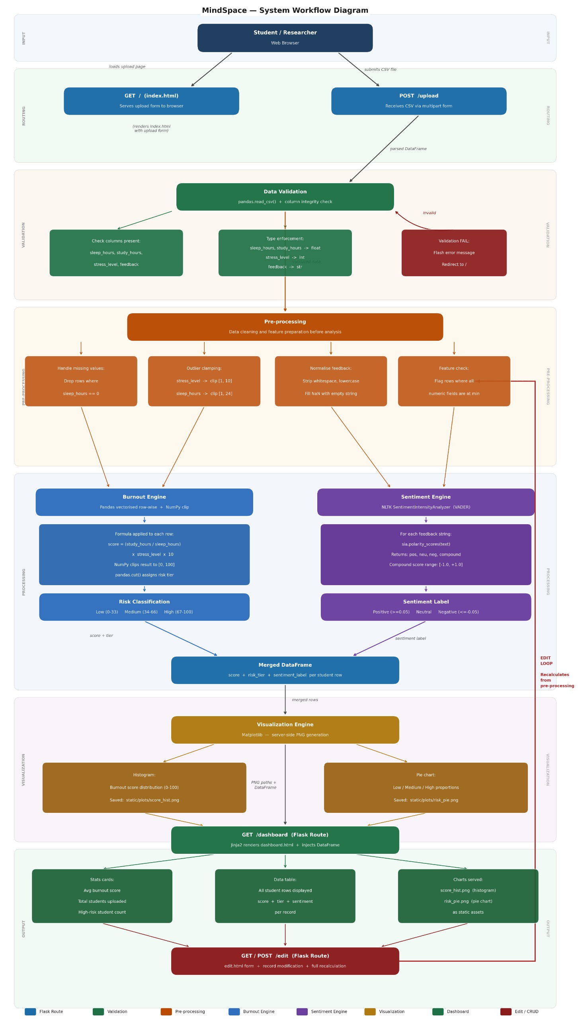
Project Flow diagram/Architecture
6

Slide 11
Project Flow diagram/Architecture
6

Slide 12
Project Flow diagram/Architecture
6

Slide 13
Project Timeline
Week | Task
Weeks 1-3 | Topic Selection, Team Formation, & Synopsis Submission
Weeks 4-6 | Data Collection, Literature Review, Backend Integration & Mid-Term Viva
Weeks 7-9 | Re-designing the "Burnout Algorithm" & Database Schema.
Weeks 10-11 | Frontend Development (Dashboard & Editing Suite).
Weeks 12-14 | Final Report Writing, Demo Video, & Final Submission

Slide 14
Data and Resources
Data Sources:
Student Stress Dataset (Kaggle): For calibration of lifestyle metrics (Sleep, Study, Stress).
Student Mental Health Dataset: For validating risk factors.
Reddit Mental Health Text: Used to test the VADER sentiment engine on informal language.
Hardware/Software:
Language: Python 3.x
Database: SQLite (Session storage)
IDE: VS Code / PyCharm
7

Slide 15
Project Usecases & Scope
Target Audience / Use-cases:
University Counselors: To identify "High Risk" students who need immediate intervention.
Administrators: To track semester-wide stress trends against exam schedules.
Researchers: To correlate lifestyle habits (sleep vs. study) with mental health outcomes.
Project Scope:
In-Scope: Web interface, Data cleaning, Burnout Algorithm, Sentiment Analysis, Visualization.
Out-of-Scope: Medical diagnosis, mobile app version, integration with live biometric sensors.
5

Slide 16
Expected Results & Impact
Deliverables:
A fully functional web tool for real-time mental health monitoring.
Visual risk profiling (Pie Charts & Histograms).
Impact:
Early Detection: Shifts focus from "Lagging Indicators" (Grades) to "Leading Indicators" (Sleep/Sentiment).
Data Integrity: Empowers educators to trust their data by removing outliers before analysis.
Holistic View: Bridges the gap between hard numbers and human feelings.
9

Slide 17
THANK YOU
11

